Slide 1
American Express Challenge 2020 Soyeong Bak, Dabeen Oh, Emmanuel Ren
Artificially intelligent
ChatBot
for travel recommendation

Slide 2

Table of Contents
Business context
A Deep Learning solution
How does the chatbot work
Further developments

Slide 3

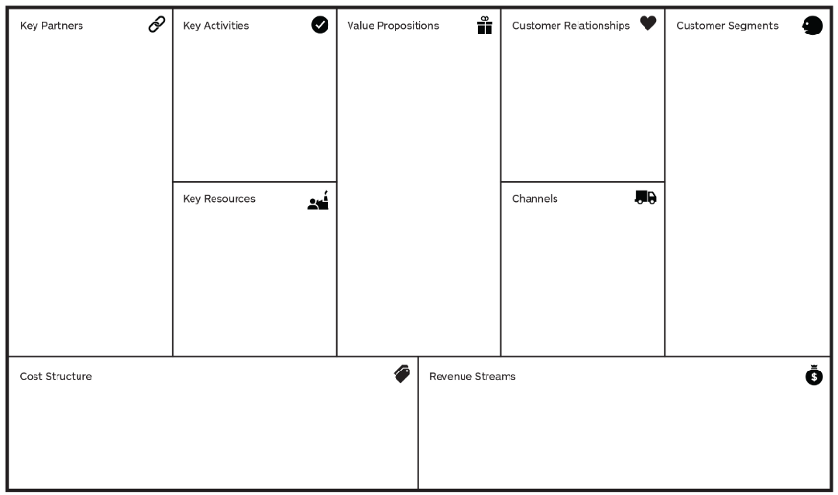
Business insights of American Express:
Values added by an AI chatbot
Banks
Airlines (ex. Delta Sky Miles)
Merchants
Hotels (ex. Hilton)
Investors
Travel Guides
Marketing
Customer Support
Partnerships
IT developments
Travel advice
corporate travel management
Credit cards for small businesses
Means of payment accepted widely
Convenience
find the right tour
Membership reward
Assistance
Security trust
Retail Customers
Merchants
Different size of businesses for card service and travel related service
Make it much more easier and faster to
Travelers who are having a hard time planning
Different tours in Travel Guides can get more exposure
Give more personalized travel advice
59000 employees
Bargain Power
Contracts with Business
Acquisitions
Travel resources
Travel Guides (ex. Lonely Planet)
Bank branches
Internet
Mobile App
Contra revenue
Customer rewards
Salaries
Marketing costs
Products : charge cards, credit cards, traveler's check
- discount revenues
- interest
- net card fees
Service: insurance, travel, finance
- travel commission
Can reduce customer service costs up to 30%
according to Chatbots Magazine
- improve overall travel service experience

Slide 4


Neural Network for classification problems
Sentence to classify
We have a list of intents and want to classify sentences into these classes
Bag of words vector
that contains the frequency of each word of a vocabulary bag
Conventional neural network
It only contains fully connected layers
historical
monuments
Which
the
what
why
places
.
.
.
walking
1
1
0
0
1
.
.
.
1
1
Activation function
(relu or tanh)
0.9
1
w₁
0
w₂
animals
“Which places provide
the best historic
walking areas in Beijing?”
0.06
0
w₃
1
.
.
.
night
tour
.
.
.
w_{N}
0.04
1
Input layer
Hidden layer
Output layer
For a given input vector a neural network can fit proper weights so that it predicts the class it belongs to
A conventional neural networks presents 3 main problems, it doesn’t take account of the meaning of the words, the context of the words and the order of the words
Conclusion

Slide 5
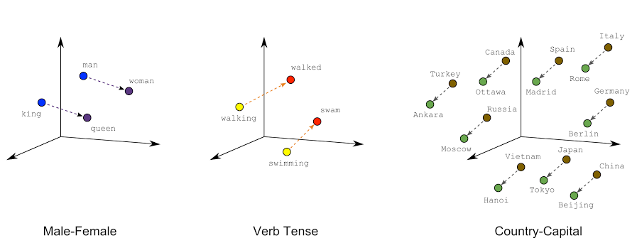
Word embeddings to encode meaning
Each word is encoded into a vector that describes the meaning of each word in a N dimension space
This meaning is fixed for a given embedding matrix, this approach solves the meaning issue but not the context
Conclusion

Slide 6
Why RNN for intent classification?
RNNs are good in handling sequential data (use for time series). The order in the sentence could be handled using RNNs.
Output
Y_{t}
Y_{T-1}
Y_{T}
Y_{T+1}
RNN
RNN
(T-1)
RNN
(T)
RNN
(T+1)
Output sent back to itself
=
Unfold
X_{T-1}
X_{T}
X_{T+1}
Input
X_{t}
t
RNNs allow the model to take account of the context using feedback loops
A problem subsist, the sensitivity decays exponentially over time as new inputs overwrite the activation of hidden units and the network forgets earlier inputs. This is the vanishing gradient problem
Conclusion

Slide 7

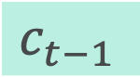

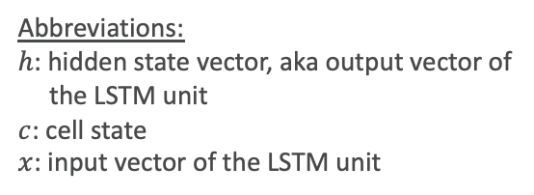
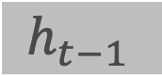

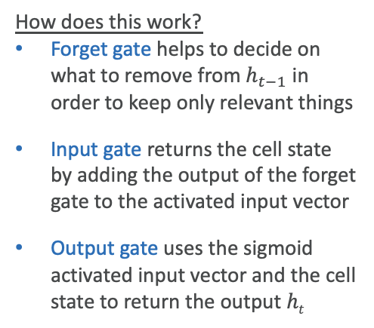
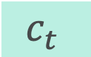



Using LSTM unit to improve our RNN
$$ht$$
output
Forget gate
Input gate
Output gate
How does this work?
Forget gate helps to decide on what to remove from $h_{t−1}$ in order to keep only relevant things
Input gate returns the cell state by adding the output of the forget gate to the activated input vector
Output gate uses the sigmoid activated input vector and the cell state to return the output $ht$
$$c_{t−1}$$
$$c_{t}$$
$$×$$
+
tanh
$$×$$
$$×$$
$$h_{t−1}$$
σ
σ
tanh
σ
$$ht$$
Abbreviations:
$h$: hidden state vector, aka output vector of
the LSTM unit
$c$: cell state
$x$: input vector of the LSTM unit
Feedforward
$$xt$$
Legend:
copy
layer
Pointwise operations
Forget gates decide which of the previous words are relevant, which solves vanishing gradient problems
An embedding layer combined with LSTM properly takes account of the meaning and the orders of the word, but the context is only partially tackled by a forward/backword feedback (unidirectional)
Conclusion

Slide 8
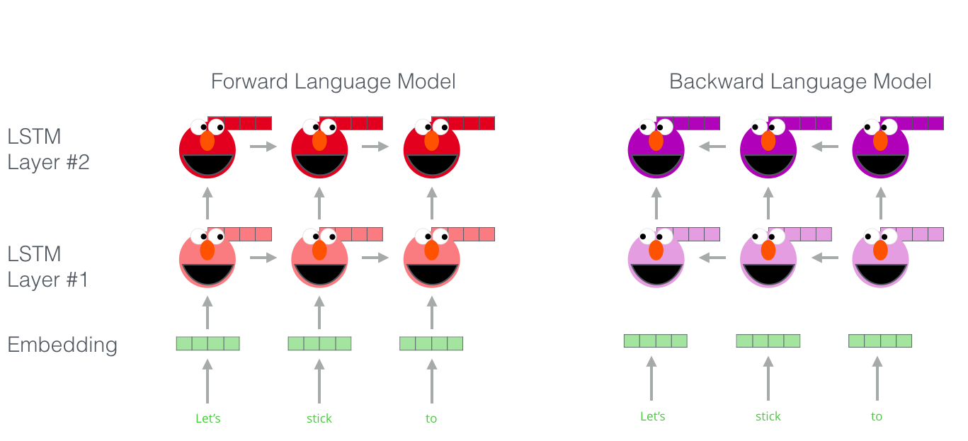
Why bidirectionality is all we need?
A LSTM-RNN needs to choose to feed information forward or backward. In either cases, it advantages the beginning or the end of the sentence
To simulate the human mind during reading, a model needs to look at the whole sentence
Conclusion

Slide 9
What is Bidirectional Encoder Representations from Transformers (BERT)? How did we fine-tuned it on our dataset?
Our Dataset
Intents
NSP
Mask LM
Mask LM
BERT
BERT
C
T_{t}
T_{N}
T_{[SEPT]}
T₁'
T_{M}'
C
T_{t}
T_{N}
T_{[SEPT]}
T₁'
T_{M}'
E_{[CLB]}
E_{t}
...
E_{N}
E_{[SEPT]}
E₁'
...
E₁'
E_{[CLB]}
E_{t}
...
E_{N}
E_{[SEPT]}
E₁'
...
E₁'
[CLB]
Tok 1
...
Tok N
[SEPT]
Tok 1
...
Tok M'
[CLB]
Tok 1
...
Tok N
[SEPT]
Tok 1
...
Tok M'
Masked Sentence A
Masked Sentence B
Questions
Unlabled Sentence A and B Pair
Question / Intent Pair
Pre-training
Fine-Tuning

Slide 10

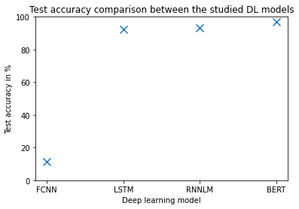
Let’s test these models on real tasks: Intent classification for chatbot design
Comparative complexity of the model used
Test accuracy comparison
Model | Pre-trained | parameters | meaning | order | context
FCNN |  | 430k
LSTM |  | 200k | X | X | /
RNNLM | X | 48M | X | X | /
BERT | X | 110M | X | X | X
The pre-trained models usually leverages on their training on a large dataset to give better performances
The addition of complex features improves the performance of the models. BERT has a test accuracy of 96.9% by using only 4 epochs to train
Conclusion
For more details on the training procedure of the models, please look at the notebook of the github

Slide 11
A chatbot exposed on a Slack channel
SLACK web client
(amexbot_channel)
@amexbot Hello
Hi I’m amexbot
Raw data
{“text”: “@amexbot Hello”}
Raw data
{“text”: “Hi I’m amexbot”}
HTTP tunnel via ngrok
HTTP tunnel via ngrok
Python script mainbot.py
ai_bot.SlackMessage()
FCNN
LSTM
RNNLM
Fine-tuned BERT

Slide 12


The main components of the amexbot Software
Python class library: ai_bot.py
class SlackMessage():
Methods to loop over Model class objects and predict answers from sentences (used by main.py and mainbot.py)
class Model*():
The wildcard character (*) replaces:
Fcnn (Fully Connected Neural Network)
Rnnlm (Reccurent NN Language Model)
Lstm (Long Short-Term Memory RNN)
Bert (Bidirectional Encoder Representations from Transformers)
The classes all contains these 3 methods:
_get_input_array() #preprocessing
_build() #build the NN architecture
_train() #train the model and save the best performing iteration
Python executables: main*.py
Python script: main.py
4 DL models for intent prediction
A while loop for question-answering
Automatically generated answers /predictions
Python script: mainbot.py
class LoadingData():
Answer to event triggers (Slack Event API)
Post answers / predictions to Slack
Possible interactions with more people
Loads data from the “intents.json” data file
Contains preprocessing methods

Slide 13

Further developments
Add more complexity in the intent labeling (consider more than one country, the preference of the client, the price, …)
Expose the chatbot on a proper website (using wordpress and javascript)
Add diversity of sentences in the dataset (we could use conversation data from Slack)
Add more noise in the dataset using data augmentation

Slide 14
Conclusion
By using state-of-the-art NLP methods, we managed to solve an 8-label classification problem with 893 data points. Our best performing model, fine-tuned Bert gives extremely high accuracy on the test set
Further developments could further increase the performance of our deep learning models
To interact with our chatbot and test its robustness, please feel free to join our team on Slack and leave our bot some message on a travel in Beijing for visiting historical places, seeing animals, relaxing, participating to night tours or shows/concerts, going on a cruise or eating good food.

